Slide 1
Sociology Course Code (SS 2005)
Muhammad Zeeshan

Slide 2
SOCIALIZATION
Sociologists use the term socialization to refer to the lifelong social experience by which people develop their human potential and learn culture.
Social experience is also the foundation of personality, a person’s fairly consistent patterns of acting, thinking, and feeling.

Slide 3
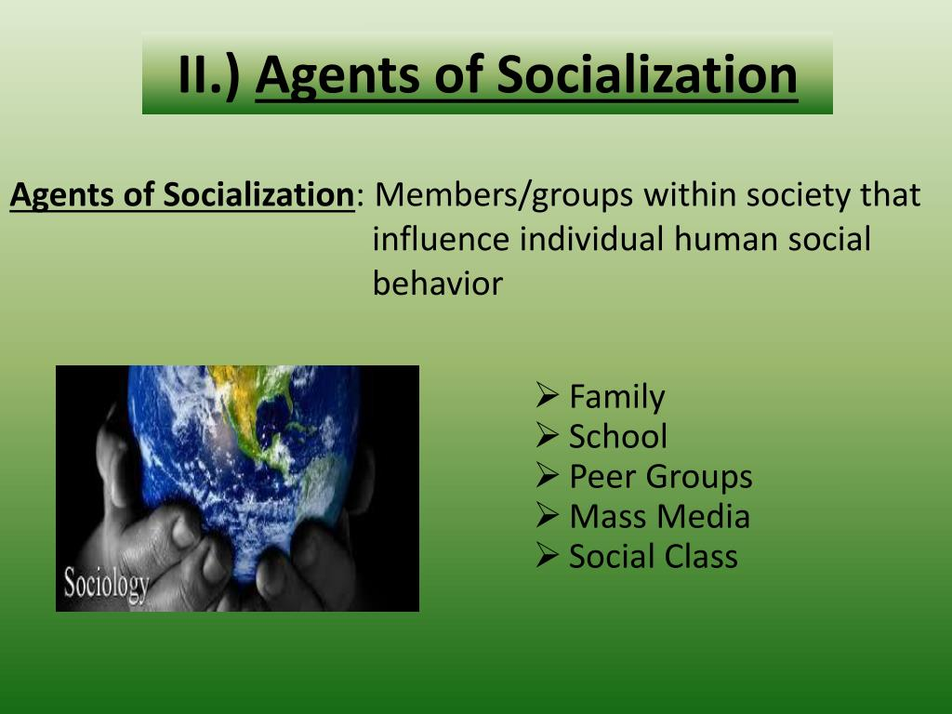

Slide 4
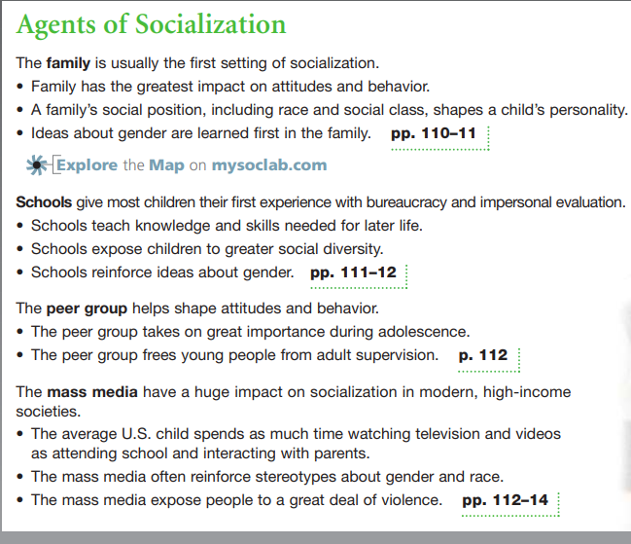

Slide 5


Slide 6
Types of Socialization
Types of Socialization include:-
Primary socialization, which occurs in childhood and involves learning the basic norms and values of one's society.
Secondary socialization, which occurs in professional settings like office, business, public dealings.
Anticipatory socialization, which occurs when one prepares for a future role or status by adopting the norms and values of that group.
Developmental socialization, which occurs throughout one's life and involves learning new skills and behaviors that are appropriate for one's age and stage.
Re-socialization, which occurs when one discards old behaviors and accepts new ones as a result of a major life change or a new social environment.
Total institution, a setting in which people are isolated from the rest of society and manipulated by an administrative staff.

Slide 7
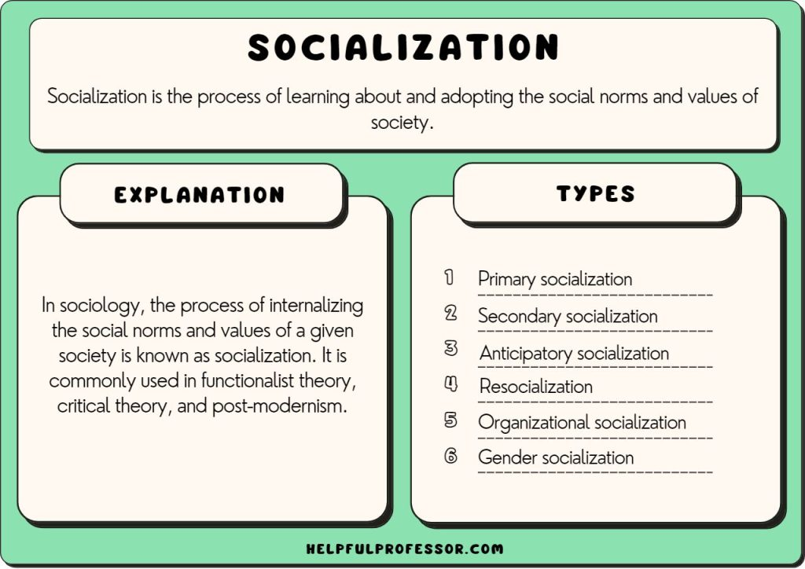

Slide 8
Human Development: Nature and Nurture
The Biological Sciences: The Role of Nature, Charles Darwin’s groundbreaking 1859 study of evolution, described in Chapter 3 (“Culture”), led people to think that human behavior was instinctive, simply our “nature.”
The Social Sciences: The Role of Nurture, In the twentieth century, biological explanations of human behavior came under fire. The psychologist John B. Watson (1878–1958) developed a theory called behaviorism, which holds that behavior is not instinctive but learned. Thus people everywhere are equally human, differing only in their cultural patterns. In short, Watson rooted human behavior not in nature but in nurture.
Without denying the importance of nature, then, we can correctly say that nurture matters more in shaping human behavior. More precisely, nurture is our nature

Slide 9
UNDERSTANDING SOCIALIZATION
Socialization is a complex, lifelong process. The following discussions highlight the work of six researchers:-
Sigmund Freud,
Jean Piaget,
Lawrence Kohlberg,
Carol Gilligan,
George Herbert Mead,
Charles Horton Cooley and
Erik H. Erikson
who have made lasting contributions to our understanding of human development.

Slide 10
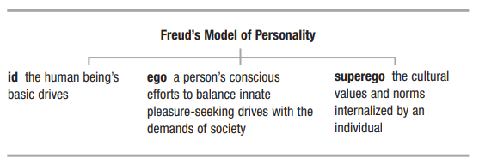
1. SIGMUND FREUD’S: MODEL OF PERSONALITY

Slide 11
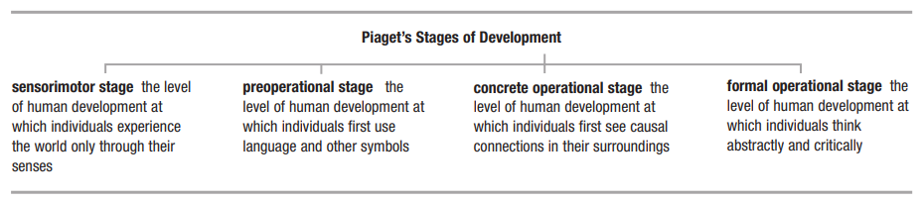
2. JEAN PIAGET’S: STAGES OF DEVELOPMENT

Slide 12
3. Kohlberg’s: Theory of Moral Development
Kohlberg’s levels of moral development are as follows:
Pre-conventional level:- children accept the authority (and moral code) of others. If an action leads to punishment, it must be bad. If it leads to a reward, it must be good.
Conventional level:- children believe that social rules and the expectations of others determine what is acceptable or unacceptable behavior. A social system that stresses the responsibilities of relationships and social order is seen as desirable and must, therefore, influence our views of right and wrong.
Post-conventional level:- here what is right is based on an individual’s understanding of universal ethical principles. What is considered morally acceptable in any given situation is determined by what is the response most in keeping with these principles.

Slide 13
4. Carol Gilligan’s: Theory of Gender and Moral Development
Carol Gilligan, whose approach is highlighted in the Thinking About Diversity box, compared the moral development of girls and boys and concluded that the two sexes use different standards of rightness.
Boys, Gilligan (1982, 1990) claims, have a justice perspective, relying on formal rules to define right and wrong.
Girls, by contrast, have a care and responsibility perspective, judging a situation with an eye toward personal relationships and loyalties.
For example, as boys see it, stealing is wrong because it breaks the law.
Girls are more likely to wonder why someone would steal and to be sympathetic toward a person who steals, say, to feed her family.
Kohlberg treats rule-based male reasoning as superior to the person-based female approach. Gilligan notes that impersonal rules dominate men’s lives in the workplace, but personal relationships are more relevant to women’s lives as mothers and caregivers.

Slide 14
5. George Herbert Mead’s: Theory of the Social Self
George Herbert Mead (1863–1931) developed the theory of social behaviorism to explain how social experience develops an individual’s personality (1962, orig. 1934).
The Self: Mead’s central concept is the self, the part of an individual’s personality composed of self-awareness and self-image. Mead’s genius was in seeing the self as the product of social experience.
First, the self is not there at birth; it develops. Mead rejected the idea that personality is guided by biological drives (as Freud asserted) or biological maturation (as Piaget claimed).
Second, the self develops only with social experience, as the individual interacts with others. Without interaction, as we see from cases of isolated children, the body grows, but no self emerges.
Third, social experience is the exchange of symbols. Only people use words, a wave of the hand, or a smile to create meaning. We can train a dog using reward and punishment, but the dog attaches no meaning to its actions. Human beings, by contrast, find meaning in almost every action.
Fourth, seeking meaning leads people to imagine other people’s intentions. In short, we draw conclusions from people’s actions, imagining their underlying intentions
Fifth, understanding intention requires imagining the situation from the other’s point of view. Using symbols, we imagine ourselves “in another person’s shoes” and see ourselves as that person does. We can therefore anticipate how others will respond to us even before we act.
The I and the Me Mead’s sixth point is that by taking the role of the other, we become self aware.

Slide 15
5(a). Parts of the Self: The I and the Me
Another way of saying this is that the self has two parts.
I: One part of the self operates as the subject, being active and spontaneous. Mead called the active side of the self the “I” (the subjective form of the personal pronoun).
Me: The other part of the self works as an object, that is, the way we imagine others see us. Mead called the objective side of the self the “me” (the objective form of the personal pronoun).
All social experience has both components: We initiate an action (the I-phase, or subject side, of self), and then we continue the action based on how others respond to us (the me-phase, or object side, of self).
Everyday life demands that we see ourselves in terms of cultural norms as any member of our society might.
Mead used the term generalized other to refer to widespread cultural norms and values we use as references in evaluating ourselves.

Slide 16
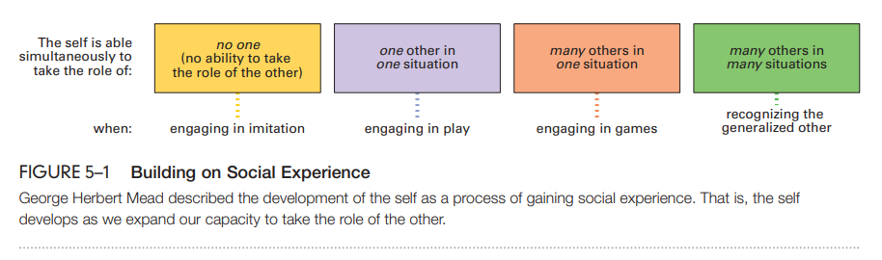
5(b). Development of the Self
According to Mead, the key to developing the self is learning to take the role of the other.
Infants can do this only through imitation. They mimic behavior without understanding underlying intentions, and so at this point, they have no self.
As children learn to use language and other symbols, the self emerges in the form of play. i.e. assuming roles modeled on significant others, people, such as parents, who have special importance for socialization.
Gradually, children learn to take the roles of several others at once. This skill lets them move from simple play (say, playing catch) with one other to complex games (such as baseball) involving many others.
By about age seven, most children have the social experience needed to engage in team sports. But there is a final stage in the development of the self. A game involves taking the role of specific people in just one situation.

Slide 17
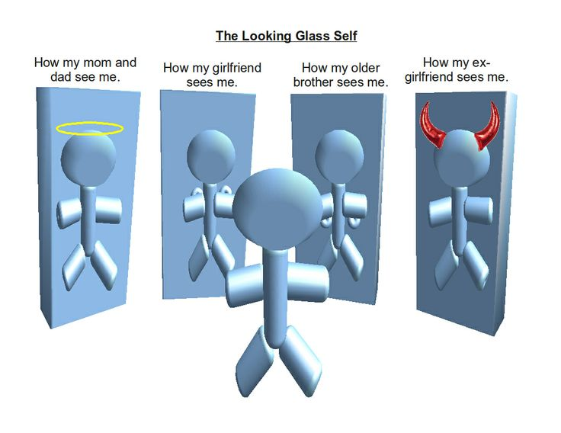
6. C.H. Cooley: The Looking-Glass Self
As we interact with others, the people around us become a mirror (an object that people used to call a “looking glass”) in which we can see ourselves.
What we think of ourselves, then, depends on how we think others see us.
For example, if we think others see us as clever, we will think of ourselves in the same way.
But if we feel they think of us as clumsy, then that is how we will see ourselves.

Slide 18
7. Erik H. Erikson’s: Eight Stages of Development
Although some analysts (including Freud) point to childhood as the crucial time when personality takes shape, Erik H. Erikson (1902–1994) took a broader view of socialization. He explained that we face challenges throughout the life course (1963, orig. 1950).
Stage 1: Infancy—the challenge of trust (versus mistrust). Between birth- 18 months, infants face the first of life’s challenges: to establish a sense of trust that their world is a safe place. Family members play a key part in how any infant meets this challenge.
Stage 2: Toddlerhood—the challenge of autonomy (versus doubt and shame). The next challenge, up to age 3, is to learn skills to cope with the world in a confident way. Failing to gain self-control leads children to doubt their abilities.
Stage 3: Preschool—the challenge of initiative (versus guilt). 4 and 5-year-olds must learn to engage their surroundings—including people outside the family—or experience guilt at failing to meet the expectations of parents and others.
Stage 4: Preadolescence—the challenge of industriousness (versus inferiority). Between ages 6 and 13, children enter school, make friends, and strike out on their own more and more. They either feel proud of their accomplishments or fear that they do not measure up.

Slide 19
7. Erik H. Erikson’s: Eight Stages of Development (cont…)
Stage 5: Adolescence—the challenge of gaining identity (versus confusion). During the teen years, young people struggle to establish their own identity. In part, teenagers identify with others, but they also want to be unique. Almost all teens experience some confusion as they struggle to establish an identity.
Stage 6: Young adulthood—the challenge of intimacy (versus isolation). The challenge for young adults is to form and maintain intimate relationships with others. Falling in love (as well as making close friends) involves balancing the need to bond with the need to have a separate identity.
Stage 7: Middle adulthood—the challenge of making a difference (versus self-absorption). The challenge of middle age is contributing to the lives of others in the family, at work, and in the larger world. Failing at this, people become self-centered, caught up in their own limited concerns.
Stage 8: Old age—the challenge of integrity (versus despair). As the end of life approaches, people hope to look back on what they have accomplished with a sense of integrity and satisfaction. For those who have been self-absorbed, old age brings only a sense of despair over missed opportunities.

Slide 20
Q&A Session

